Slide 1
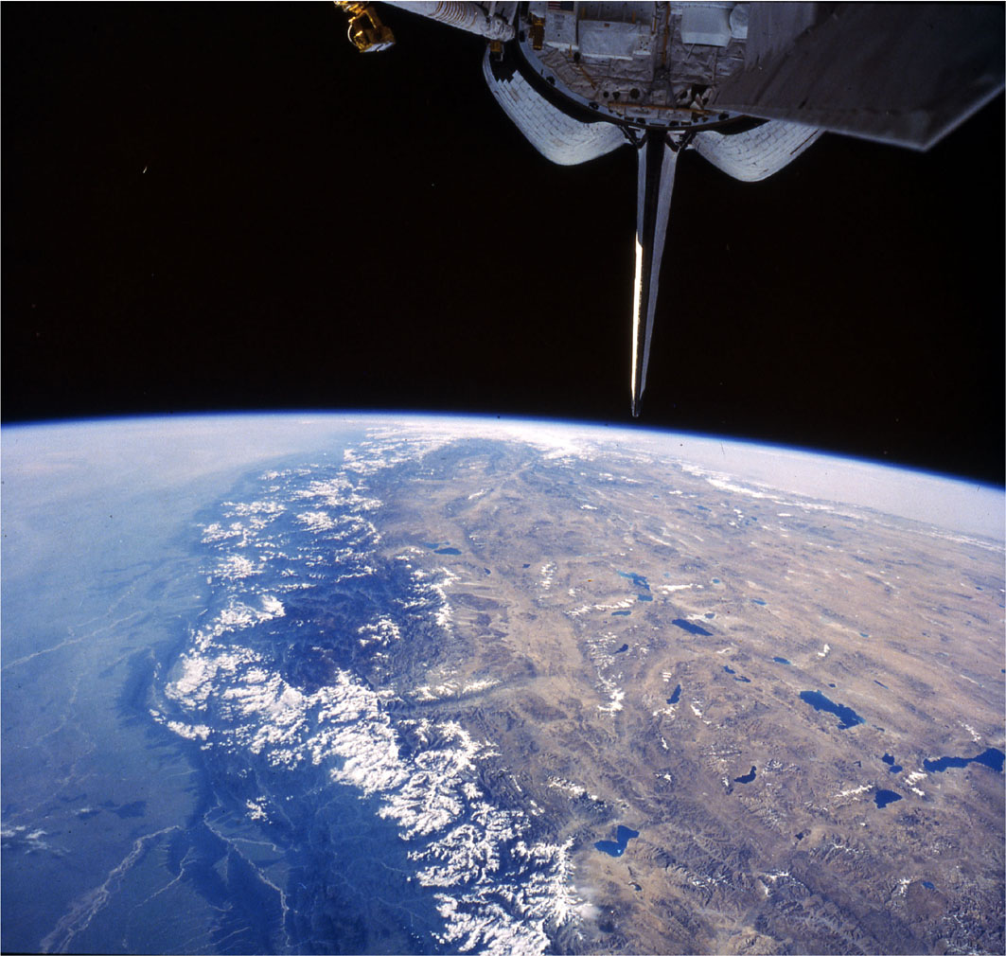
TERRAIN ANALYSIS
Aim: introduce main techniques and methods used
to map and analyse landscapes

Slide 2
Techniques that provide an accurate description of the surface terrain
Methods that enable comparison between surface features
--to detect different or similar behaviour

Slide 3


Slide 4
Why do we need markers or frames of reference?
To monitor change in vertical and horizontal
Need global frame of reference = Geoid (next week)
Ground based measurements largely replaced by satellite based measurements
Began with satellite ranging (SLR) in 1970’s
and Global positioning system (GPS)

Slide 5
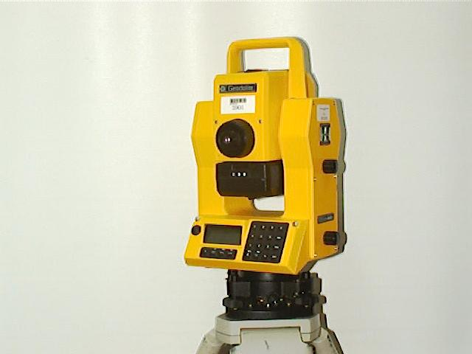
Traditional (ground-based) surveying
Triangulation,
Trilateration
Leveling
Most surveying now done using a geodolite which records the time taken for a laser pulse to bounce back off a distant reflector
- cheap
- restricted to short distances (near-field) up to 20km

Slide 6
Measurements in the vertical
Based on leveling-line survey (spirit level) approach
leveling techniques;
Differential,
Trigonometric,
In addition have
Barometric methods (many hand held gps now have this)

Slide 7
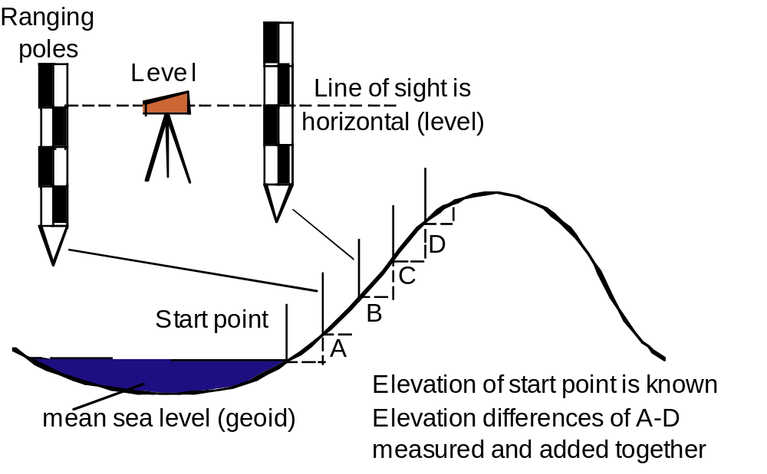
Differential (leap-frog) leveling readings are made on two calibrated upright ranging poles
Difference between readings = difference in elevation between points
Most accurate of the three methods

Slide 8
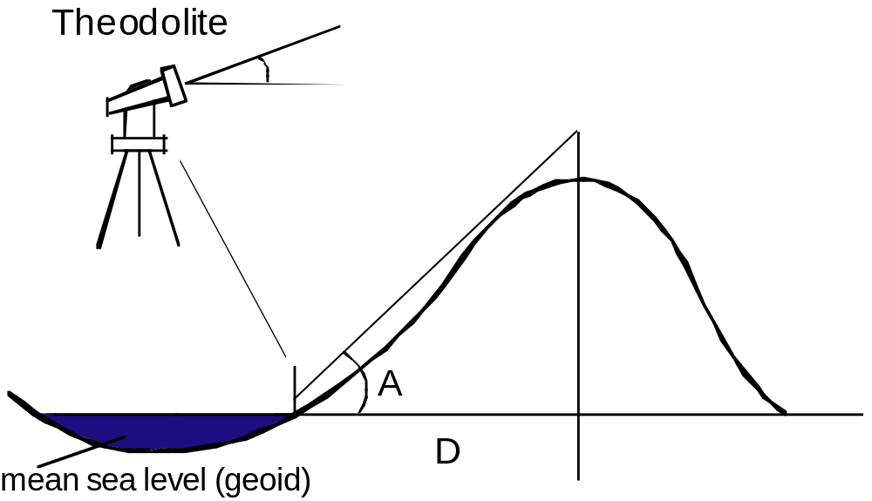
Trigonometric leveling
Measuring a vertical angle from a known distance with a theodolite and using trigonometry to compute the elevation of a point
• Reference made to base station of known elevation
• Cheap but less accurate than differential leveling
• Often only practical method in mountains
Height= D x Tan A
1. Elevation known at start point
2. Horizontal distance D is measured
3. Angle A is measured.
4. Height of H given by H=D x Tan A
(Alternatively if H is known D can be determined using D = H/Tan A)

Slide 9
Barometric leveling
Differences in height obtained by measuring the difference in atmospheric pressure at various elevations using a barometer
Not as accurate as other two methodsthis
relies on "density altitude"
readings can vary by by tens to 100’s of metres due to sudden changes in air pressure due to weather
…..”Garmin barometric altimeter accuracy is published as 10 feet (3.048m) with proper calibration”..

Slide 10
PHOTOGRAMMETRY - from 3 Greek words;
– photos - light
– gramma - letter or something drawn or written
– metron - to measure
Photogrammetrists produce maps and obtain precise three-dimensional positions of points
Remote sensing analyse and interpret images for information about the earth’s land and water areas
Photogrammetry is the science of obtaining information about physical objects and the environment without physical contact

Slide 11
Planimetric maps contain only the horizontal position of ground features
Topographic maps include elevation data, usually in the form of contour lines and spot elevations

Slide 12
Principles
Trigonometry forms basis for photogrammetry and remote sensing techniques,
Works best when combined with parallax
Aerial triangulation delivers 3-D positions of points, in a ground-based coordinate system (e.g. X,Y,Z coordinates)
Parallax trigonometry uses two ‘stereo’ images acquired from different viewing angles
Correlation of features within the two images produce a measure of ‘parallax’ that, allow elevation values to be trigonometrically computed

Slide 13
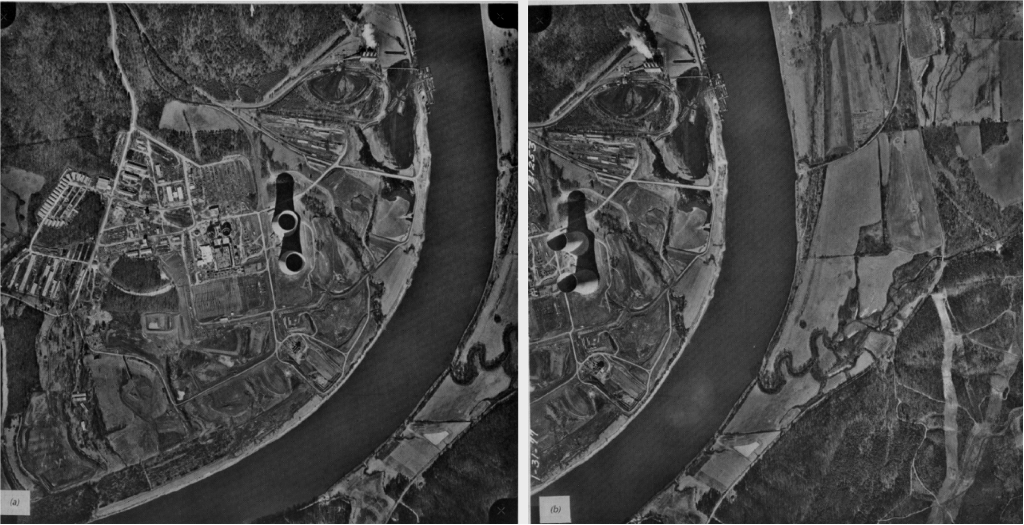

Slide 14
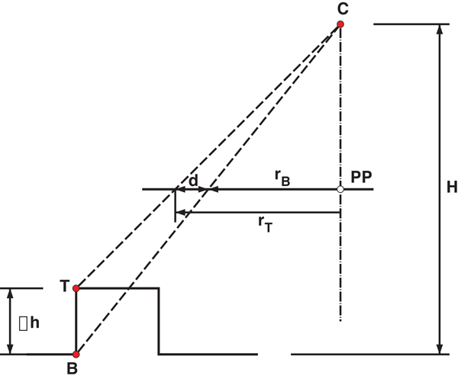
Magnitude of relief displacement
dH
r
h =
r = location co-ordinates for Top and Bottom (same)
PP principal point can be thought of as focal length of lens

Slide 15
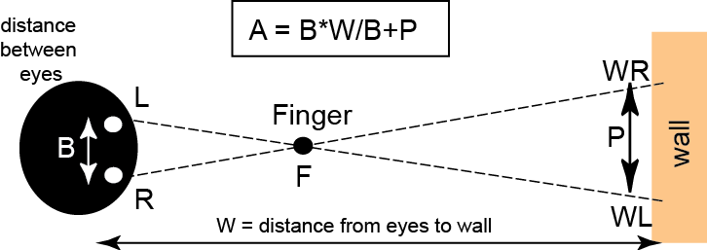

Slide 16
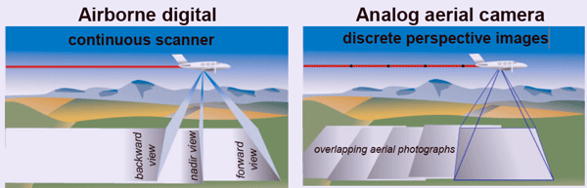
AIRBORNE AND SATELLITE DERIVED MAPS
Airborne techniques
Photogrammetry uses (mostly) vertically collected (nadir) images (frames) acquired with overlap (typically 60%).
Overlap gives two looks of the same section of terrain from different camera positions = enables elevations to be calculated from the parallax

Slide 17
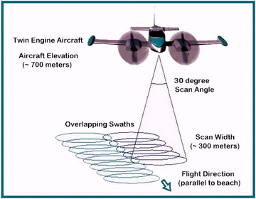
LiDAR (Light Detection & Ranging)
builds 3D models of the ground by firing a pulsed laser rapidly at a scanning mirror as the aircraft flies over the survey area
Scanning, determines 3D co-ordinates of each reflected laser pulse
LiDAR better than
Photogrammetry for
deriving elevations
Has highest accuracy
and greatest detail of
any remote sensing
technique

Slide 18
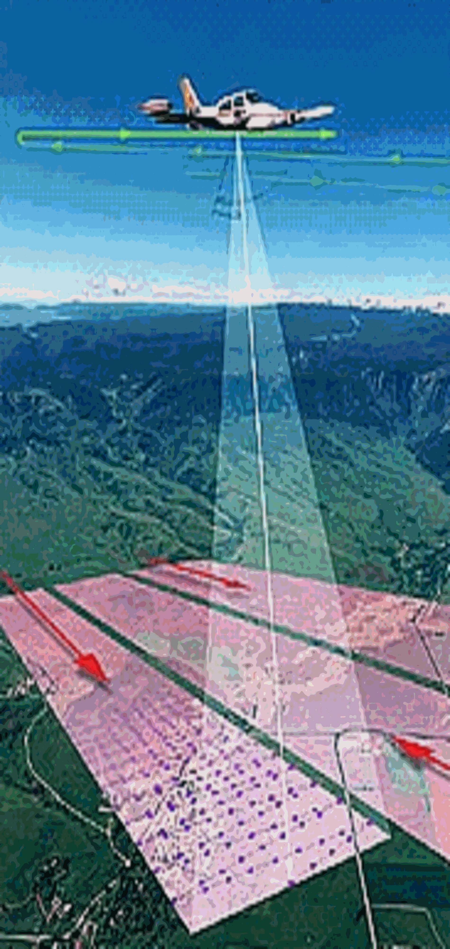
LIDAR - Light Detection and Ranging
Uses shorter wavelengths of the electromagnetic spectrum, typically in the ultraviolet, visible, or near infrared produced by lasers
Measures mostly backscattered light
Like radar it measures the distance to the first object on its path by wave reflection
The lidar can aim its laser beam in a wide range: its head rotates horizontally, a mirror flips vertically

Slide 19
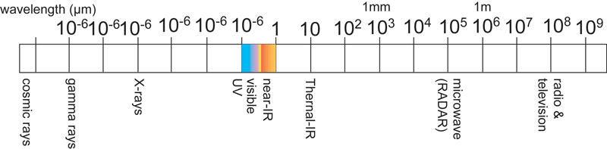
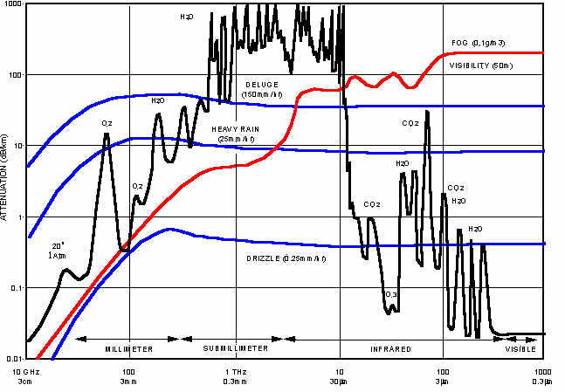
RADAR covers microwave part of electromagnetic spectrum
Microwaves least
affected by the
atmosphere

Slide 20
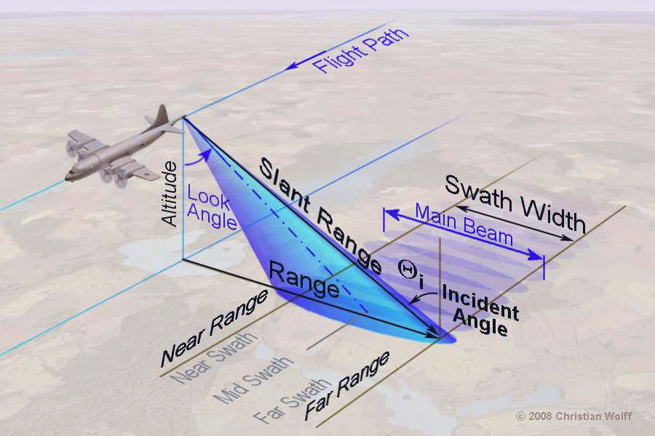
Time difference between transmission and receipt of radar echo is a function of distance or surface elevation
SLAR =
side-looking
airborne radar
Also known as
SLR,
side-looking
radar
Resolution is determined by pulse duration and length of the antenna aperture

Slide 21
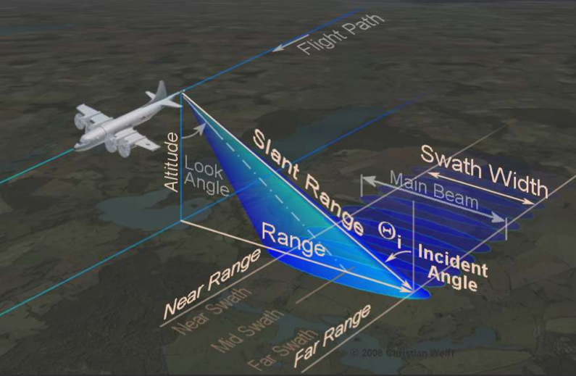
Side-looking airborne radar (SLAR) uses mainly aircraft
H λ
λ Cos θ
Resolution =
Equation shows increasing altitude = fall in resolution i.e. higher go = longer antenna

Slide 22
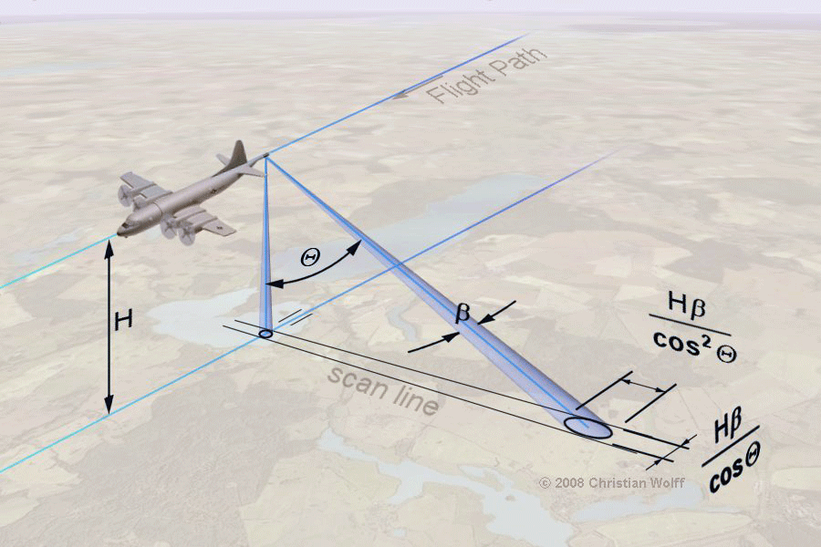
at 6 km height SLAR has a resolution of 40m
at 600 km height SLAR has a resolution of 4000m
SLAR requires a large antenna for good angular resolution
i.e. higher radar device the longer the antenna needs to be

Slide 23
SAR (synthetic aperture radar)
Developed to overcome resolution limitations of SLAR
Exploits the moving platform (e.g. satellite) to synthesise a long antenna

Slide 24
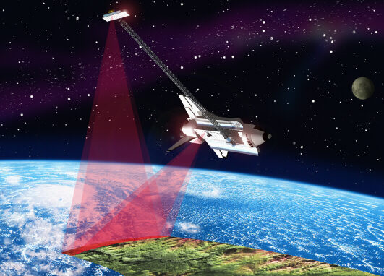
Satellite based techniques
Four main approaches to producing elevation data
Satellite laser ranging (SLR) uses satellite at fixed, known height serving as reference marker against which lasers beams are bounced off from the ground
2) Image Correlation - two ‘stereo’ images, acquired from different viewing angles. Parallax of objects used to compute elevation
3) Interferometry
e.g SRTM Shuttle radar topography mission 2000
4) GPS system

Slide 25
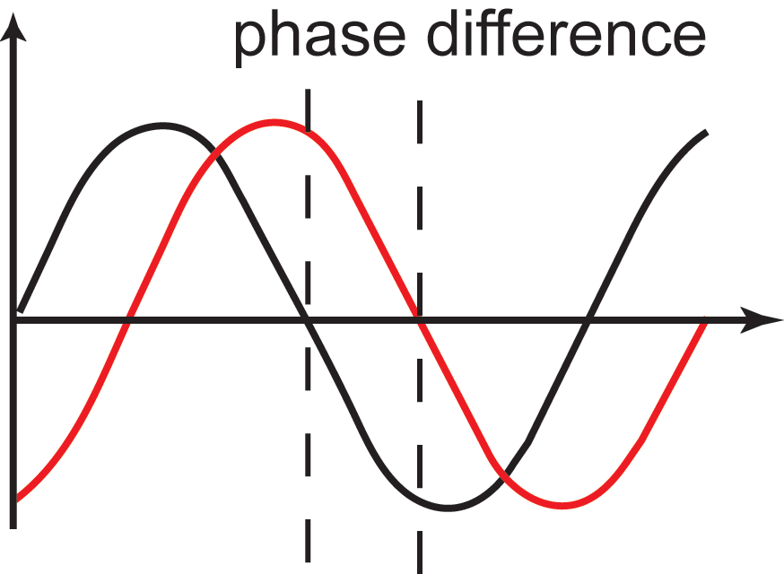
SAR Interferometry uses the phase of the reflected radiation
Compares known phase of outgoing wave with return signal
phase of return wave (number of whole wavelengths plus a fraction of a wavelength) depends on distance to ground
= elevation

Slide 26
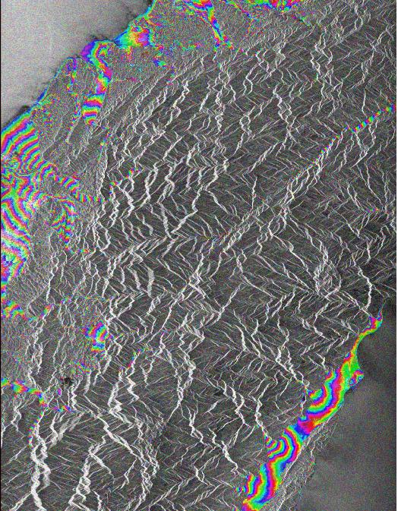
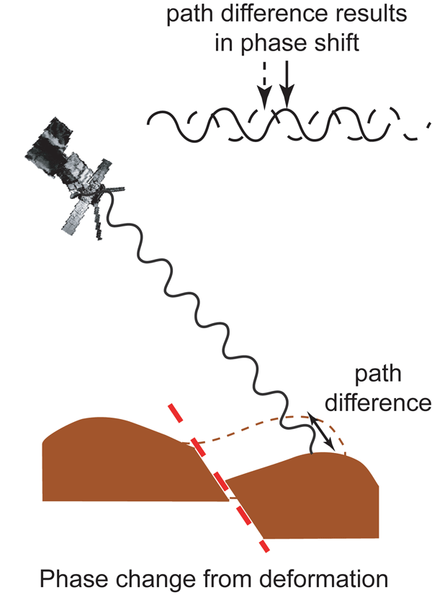
InSAR - Interferometric synthetic aperture radar
Can measure cm scale changes in deformation over days or years

Slide 27
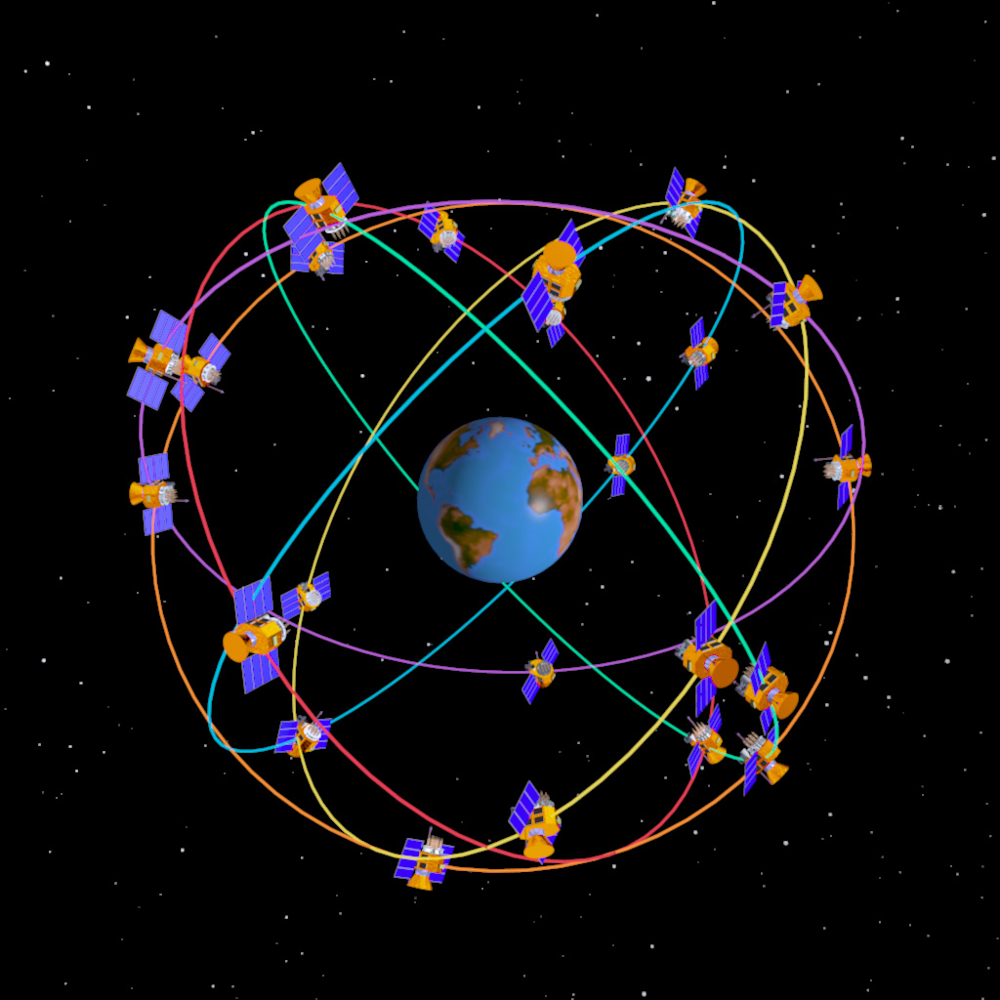
GPS based on 27 satellites orbiting at 20,000km
Each satellite transmits
2 signals @ 1575.4 MHz
1227.6 MHz
Signal gives satellite location and time of signal transmission relative to on board atomic clock = enables correction for time delay as it passes through ionosphere
Several different GPS positioning approaches;

Slide 28
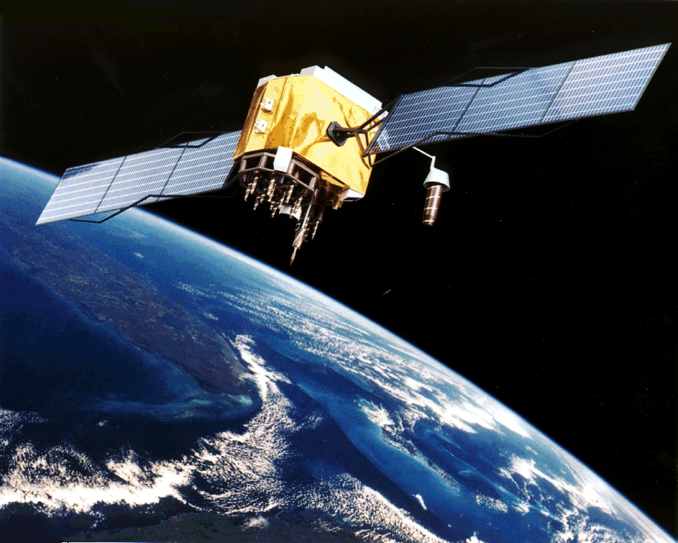
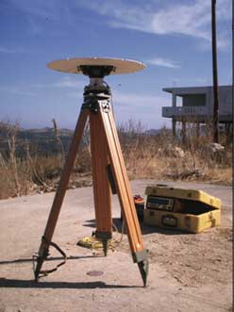
Use of GPS in landscape studies
For positioning and mapping;
1. Real-time differential positioning (DGPS)
2. Post-processed relative positioning (PPR)
3. Real-time kinematic positioning (RTK)

Slide 29
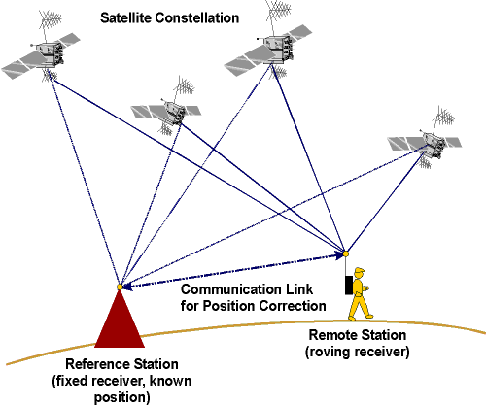
Real-time differential positioning (DGPS)
Used for general mapping
Data processing is real-time & referenced to base station
Accurate on the horizontal to ~1-5m
Relatively cheap

Slide 30
Post processed relative positioning (PPR)
Used for general mapping
Stores information from roving receiver and base station
Data processed later using specialised software
Accuracy to between 10cm and 1m

Slide 31
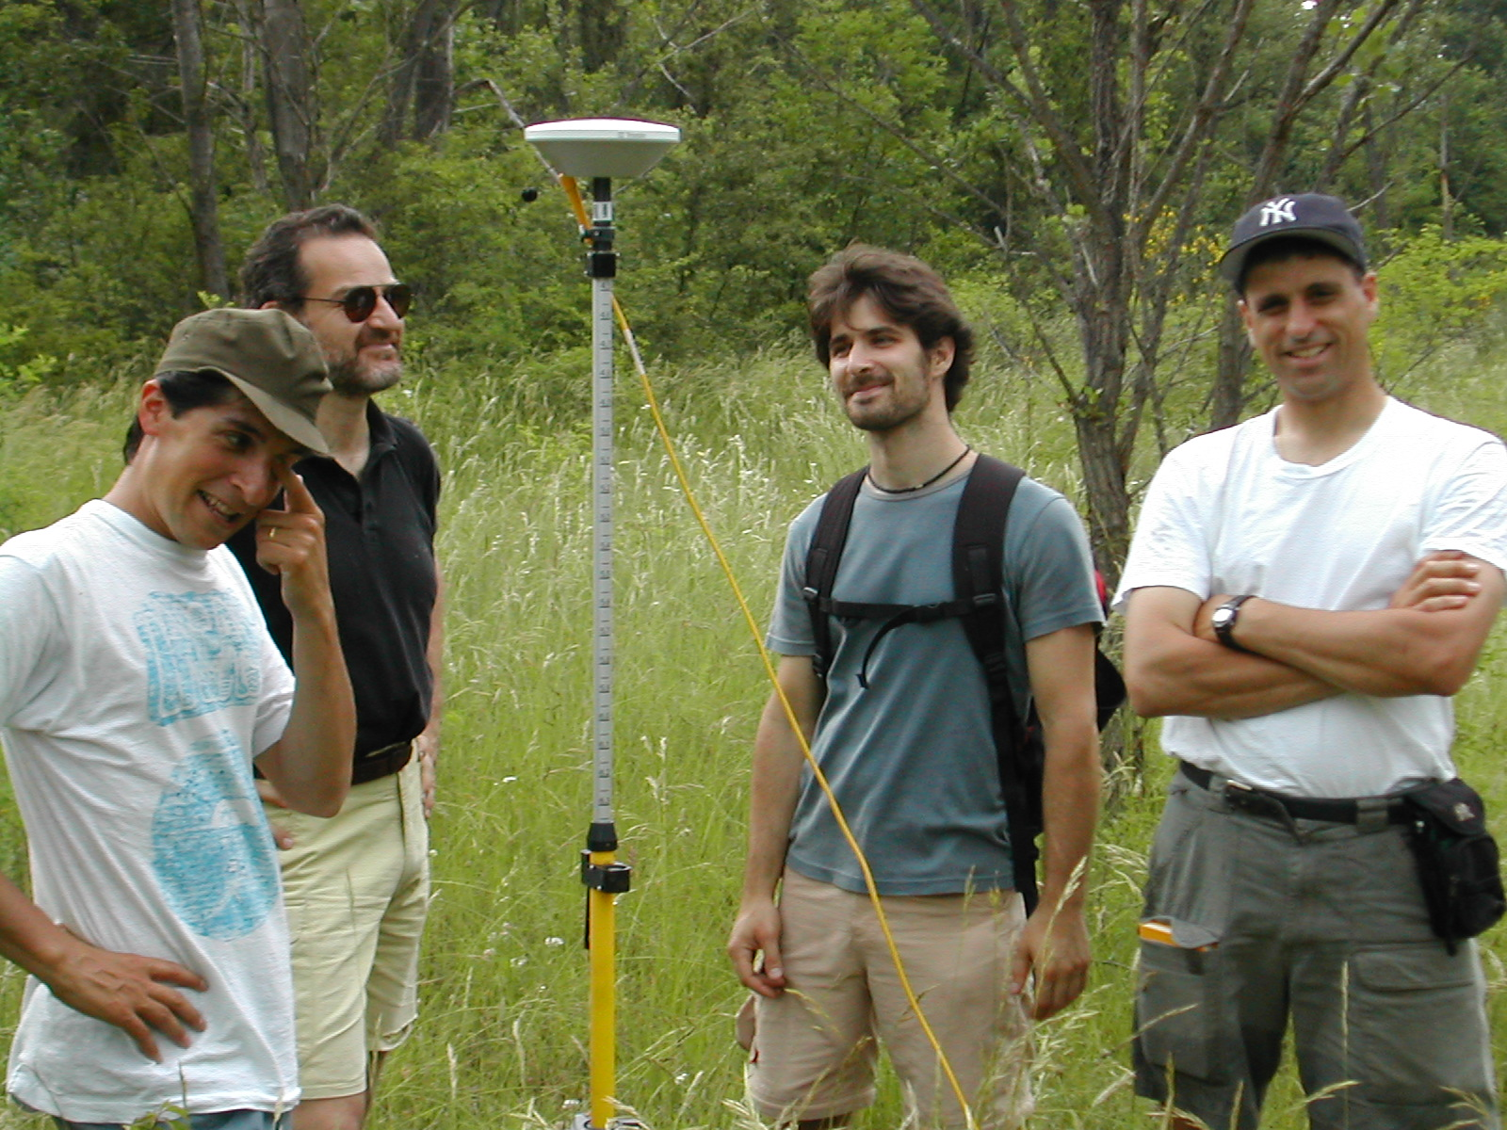
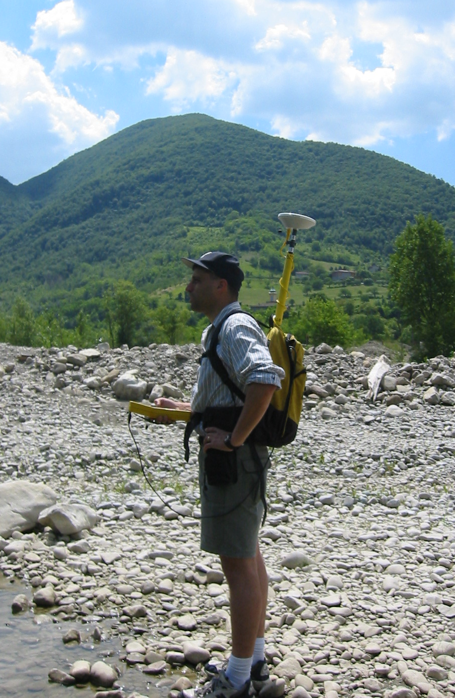

Slide 32
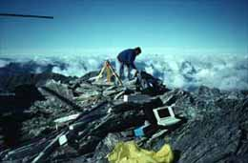
Real-time kinematic positioning (RTK)
Used for monitoring plate motions, faults, glaciers and volcanoes
Stores information from fixed stations
• For best results (<5mm) measurements take ≥24hrs
Data processed using specialised software
Average accuracy <1 cm

Slide 33
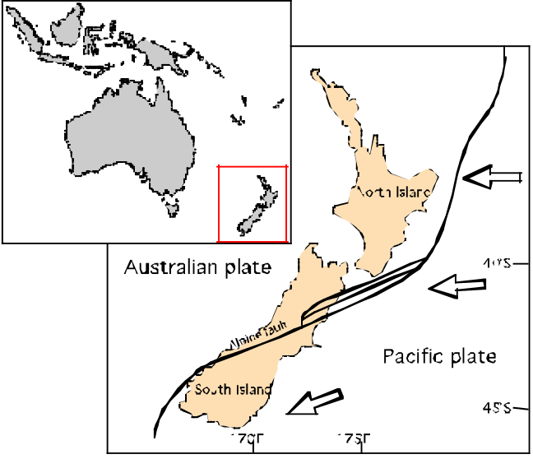
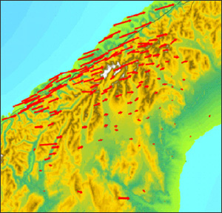
GPS on Southern Alps
New Zealand
Measurements collected over a 6yr period.
Each arrow corresponds to a station point
Measured every 2yrs
Arrows give relative scale of movement and bearing
Data show west part of South island moving at 37mm/yr relative to east coast

Slide 34
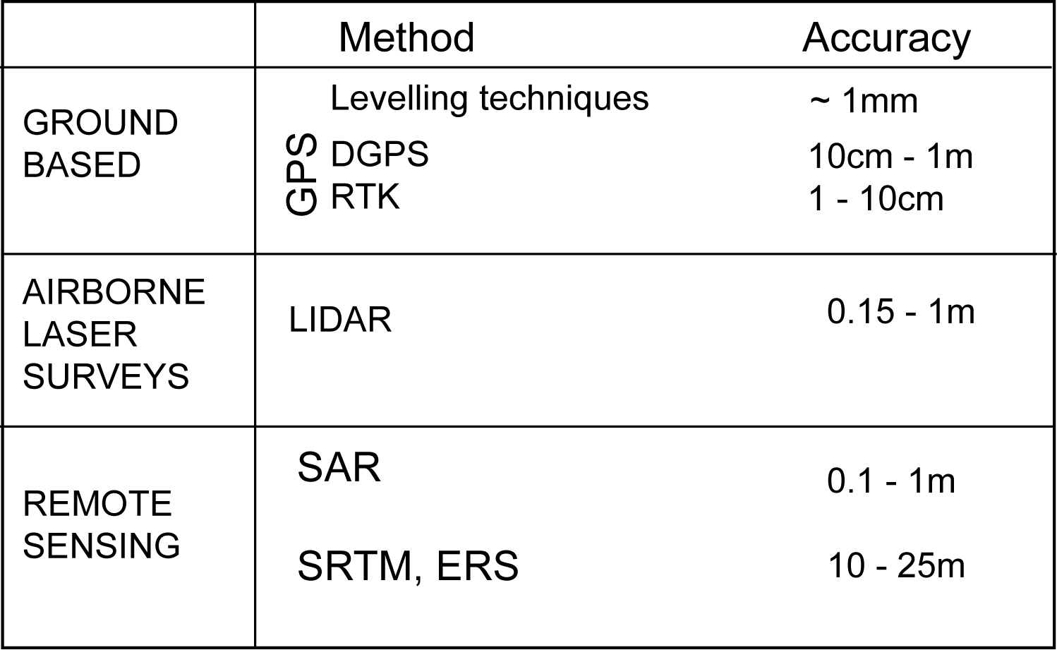
Comparison of typical surface elevation accuracy

Slide 35
TOPOGRAPHIC DATABASES AND DEM's
(digital terrain models)
DEM= quantitative model of surface topography
- data points arranged in a grid, and stored in a digital format
DEM's data sources of data include;
Groundbased surveys
Existing maps
Photogrammetry
LiDar
Satellite remote sensing (radar)
DEM accuracy varies according to sampling density and method of measurement

Slide 36
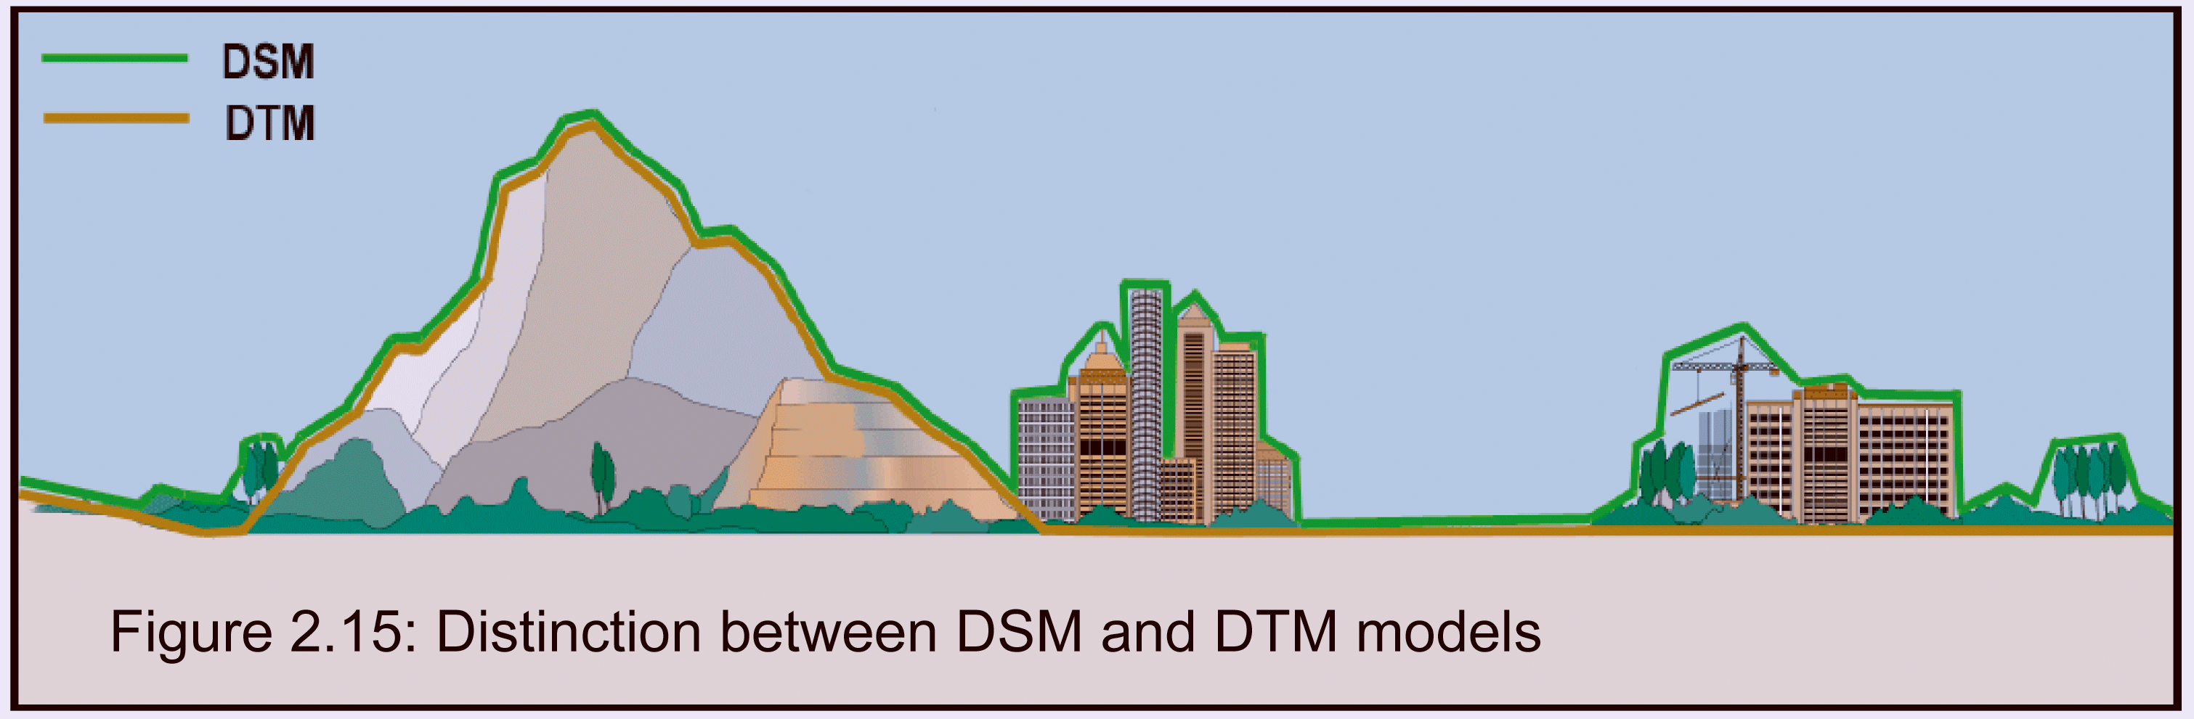
Two distinctions to note:
1) A Digital Surface Model (DSM) includes measurements of terrain and upper land cover surface (tops of buildings and trees)
Digital Terrain Model (DTM) which is a representation of the ground/terrain excluding land cover
In practice a satellite derived DEM’s is usually a surface located somewhere between the true DTM & DSM

Slide 37
Horizontal accuracy depends on spacing of measured points
Vertical accuracy is a function of all error sources
Three main spacings in common use;
1-degree DEM (3-arc-second): on the ground spacing between grid points is 3 arc seconds, which is roughly 90 m, depending on latitude = poor accuracy
30 minute DEM (2-arc-second)
7.5-minute DEM (1 arc second): on the ground spacing between grid points gives ~30 meters resolution.
DEM's processed at 1/3 arc-second can give ~10m accuracy

Slide 38
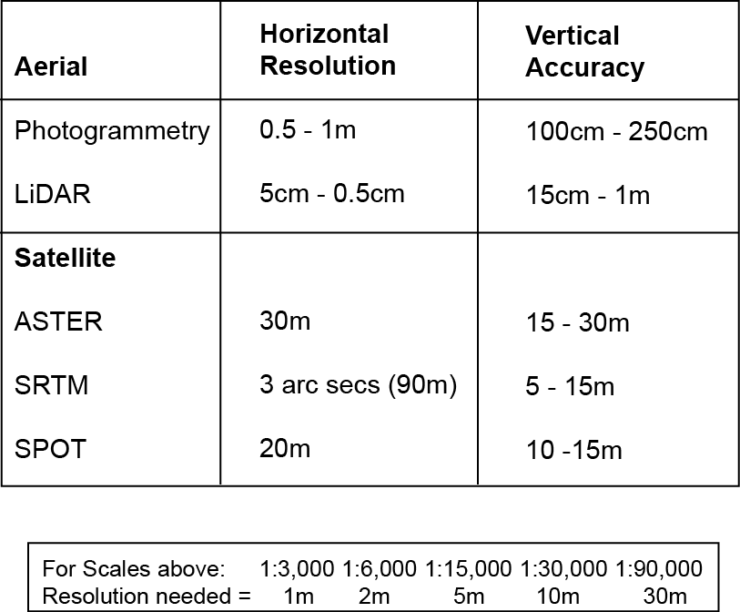

Slide 39
Widely used global DEM elevation databases;
ETOPO5 - 5 minute dataset, most data from 1988-1990 www.ngdc.noaa.gov/mgg/global/etopo5.HTML
GTOPO - 30 arcseconds (~ 1km spacing at equator) dates to 1996 www.pdaac.usgs.gov/gtopo30/gtopo30.htm
SRTM - 1 Arc second = ~ 30m at equator dates to 2000-2004 http://www.jpl.nasa.gov/srtm
AST14DEM - ASTER, 2006 improved data processing algorithms give better than 25m resolution www.asterweb.jpl.nasa.gov/NewReq.asp

Slide 40
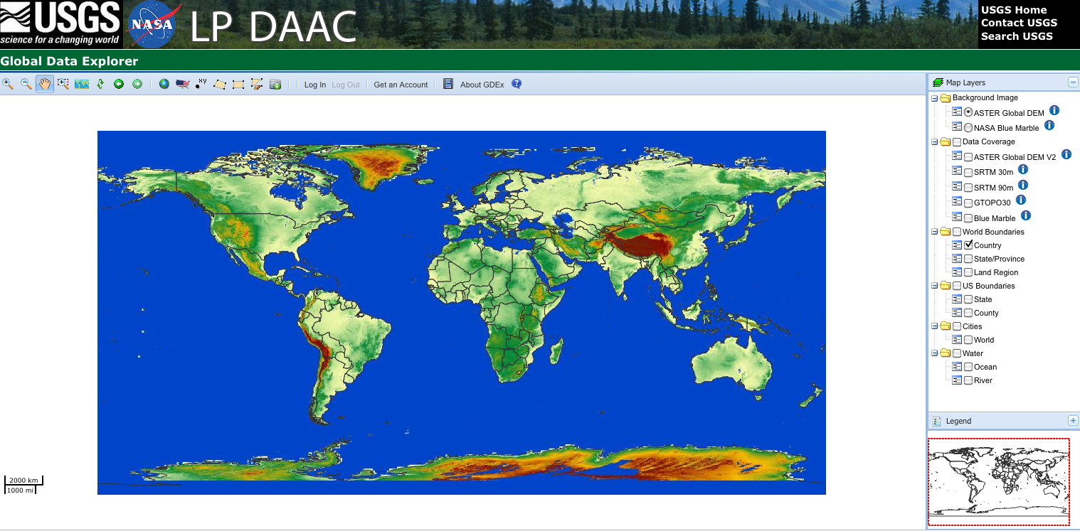

Slide 41
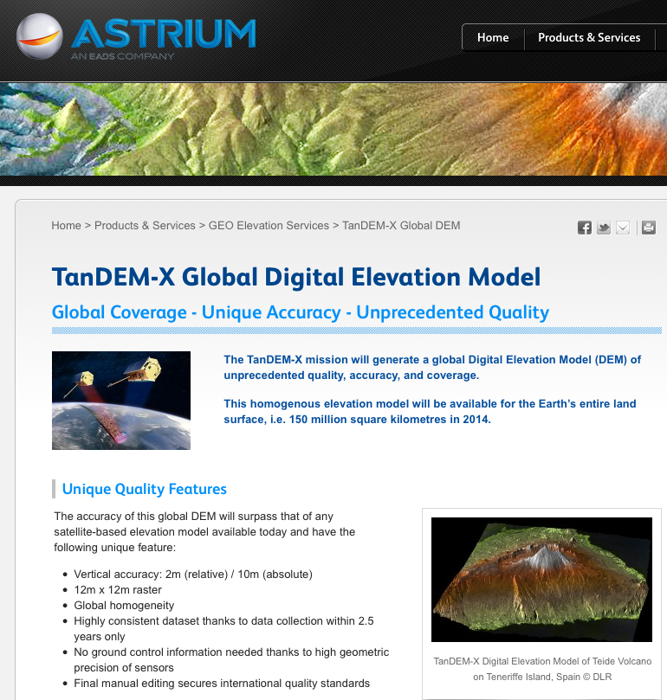

Slide 42
DEM Pixel Size
GTopo
SRTM
ASTER
1996 2004 2009

Slide 43
GTOPO30 Database
This is freely available global digital elevation model (DEM) database
http://edcdaac.usgs.gov/gtopo30/gtopo30.asp
Compiled in 1990’s by U.S. Geological Survey, based on land surface topographic data
Each data point (pixels on map ~800m apart).
Accuracy varies - depends on original data typical ± 30m
Source % of global land area
Digital Terrain Elevation Data 50.0
Digital Chart of the World 29.9
USGS 1-degree DEM's 6.7
Army Map Service 1:1,000,000-scale maps 1.1
International Map of the World 1:1,000,000-scale maps 3.7
Peru 1:1,000,000-scale map 0.1
New Zealand DEM 0.2
Antarctic Digital Database 8.3

Slide 44
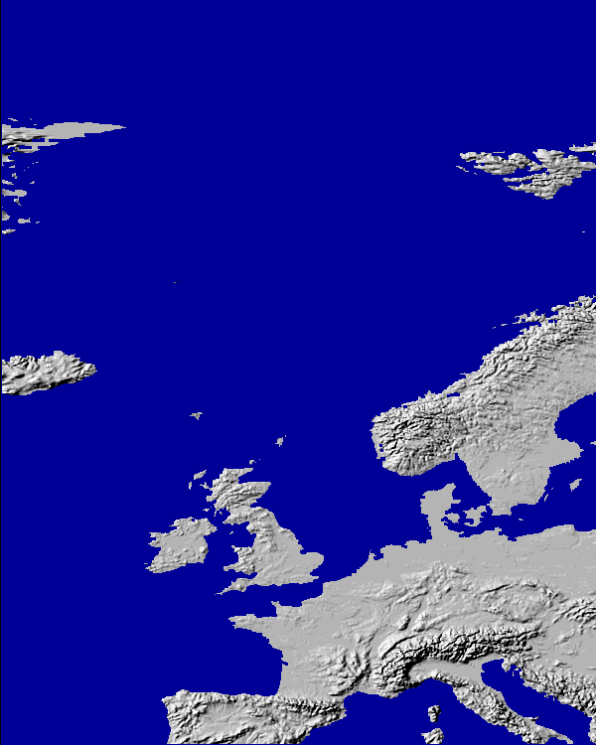

Slide 45
SRTM Database
Shuttle Radar Topography Mission (SRTM)
A specially modified radar system flew onboard Space Shuttle Endeavour for 11 days in February of 2000
The system uses radar interferometry to produce the most accurate and complete topographic map of Earth's surface
Data processing completed 2004

Slide 46
Accuracy
For latitudes between -50 & +50, the grid spacing is 1 Arc second = ~ 30m at equator
Decreases in accuracy towards the poles to 1 - 2 arc seconds
Vertical accuracy is around 16m relative to Mean Sea Level as defined by the EGM 96 geoid (lecture 3).
But, data from outside of the US only being made available at a 3 arc second resolution
SRTM can be downloaded from;
SRTM home: http://www.jpl/nasa.gov/srtm
http://eros.usgs.gov/products/elevation.html
Easier portal: http://srtm.csi.cgiar.org/

Slide 47
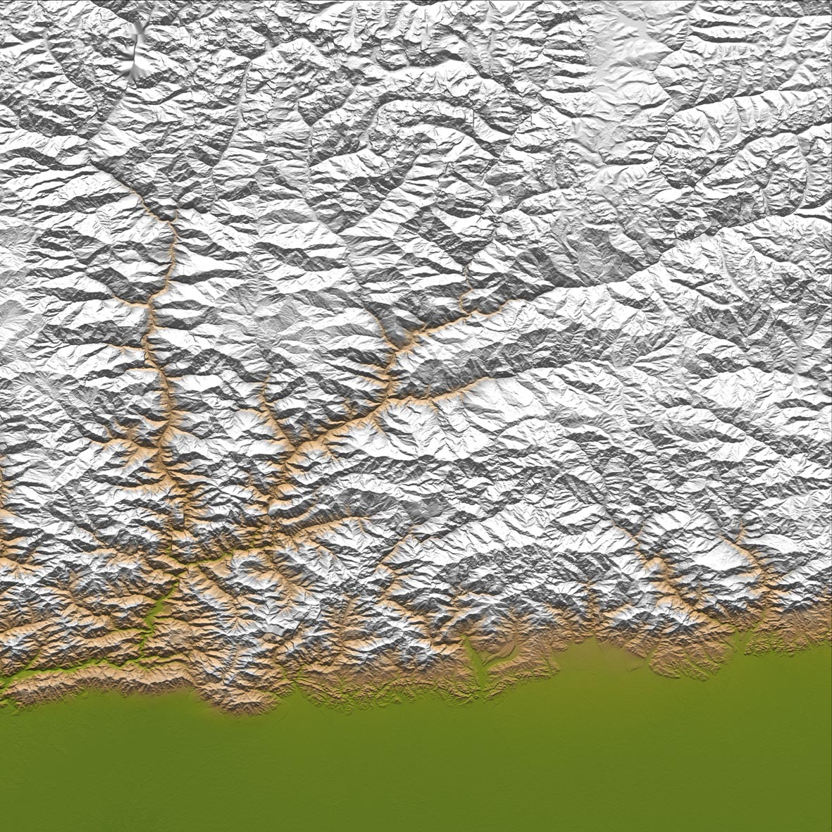
SRTM data
from E. Bhutan

Slide 48
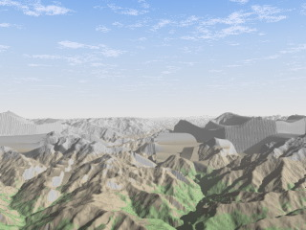

Slide 49
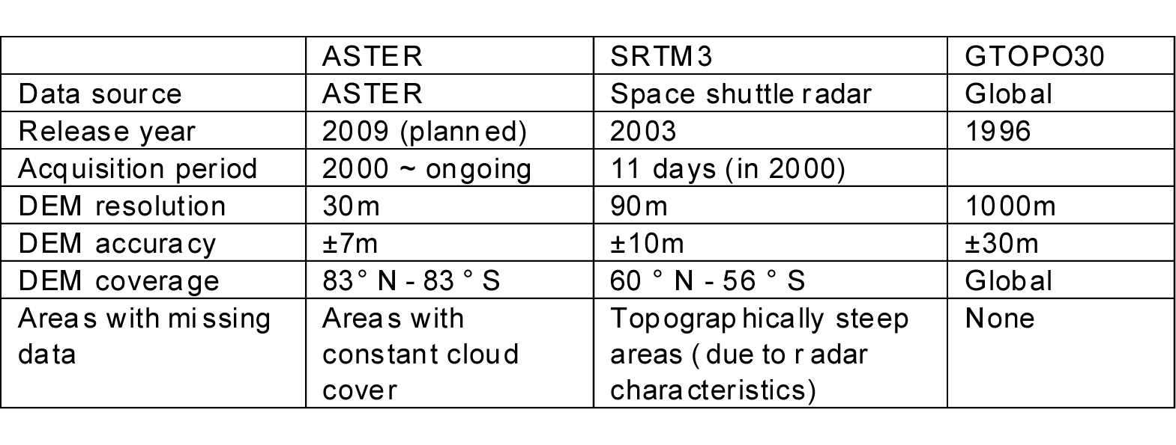
ASTER: Advanced Spaceborne Thermal Emission and Reflection Radiometer
Terra satellite launched December 1999
ASTER Global Digital Elevation Model (GDEM) released June, 2009
http://asterweb.jpl.nasa.gov/gdem.asp

Slide 50
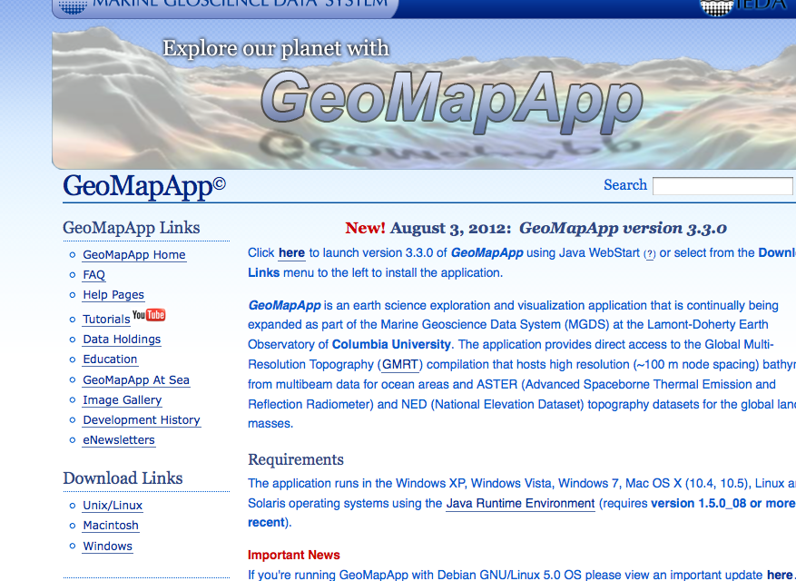
Freeware: http://www.geomapapp.org

Slide 51
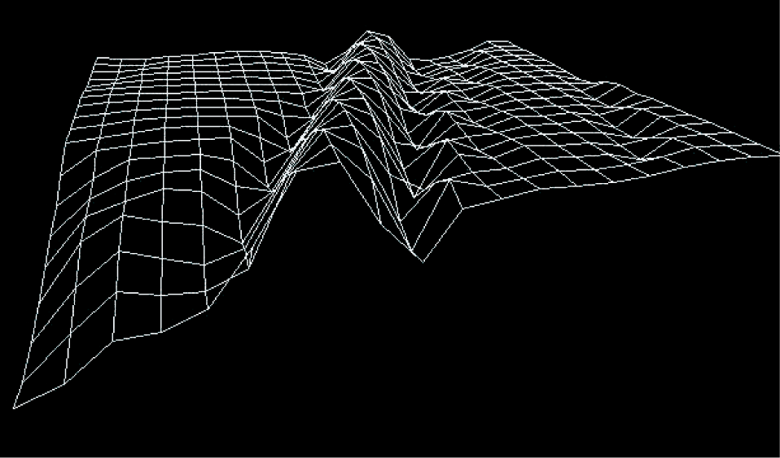
Plotting data in DEM’s
For DEM representations of the Earth's topography DEM data are generally plotted using;
GRID - A two-dimensional array of elevations that represents elevations on a regular grid

Slide 52
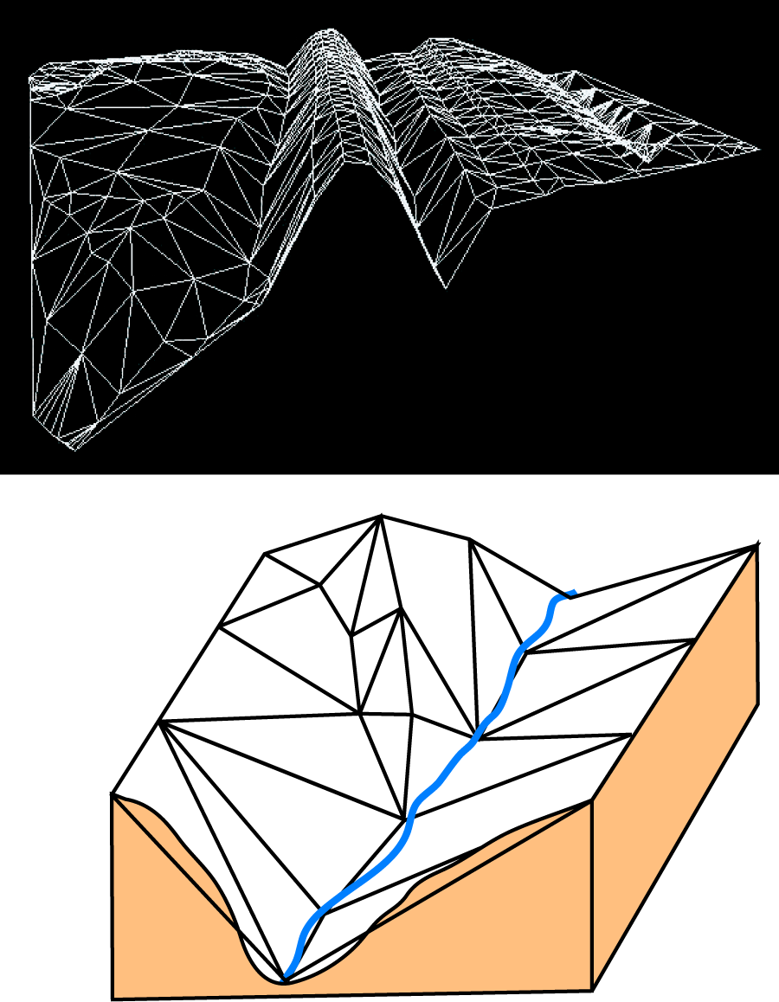
TIN (Triangular Irregular Network)
- a set of irregularly spaced xyz coordinates, interpolated to give a series of Delauney triangles
- triangles can vary in size according to the roughness of the terrain
- large triangles suite flat or smoothly sloping country whilst small triangles are better for more variable terrain

Slide 53
GRID DEMs most common - are easy to compute and computationally efficient but;
They cannot easily handle abrupt changes in elevation
2) The size of the grid mesh affects the results and computational efficiency
3) Produce large amounts of data redundancy in areas of uniform terrain
4) Cannot adapt to areas of differing relief complexity without changing the grid size
TINS - best used where considerable variation in topographic relief

Slide 54
DEM quality
Most DEM's include areas where some interpolation has been necessary
Five main factors that influence DEM quality;
1) terrain roughness (changes in relief)
2) sampling density (see below)
3) grid spacing/pixel size
4) form of the interpolation algorithm
5) vertical resolution

Slide 55
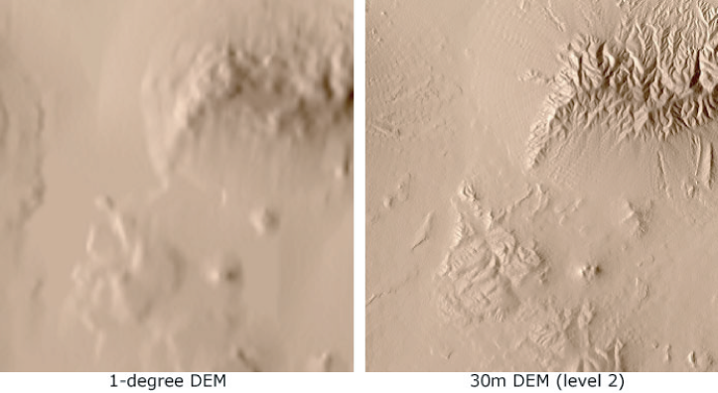
GRID SPACING

Slide 56
Data Holes
A common problem with DEM's are "no-data" holes = water, heavy shadows, extreme relief and latitude limit the quantification of elevation
Deserts also a problem - some sands have low radar reflectance
Two main ways to limit these types of problem;
a) data interpolation,
b) hole filling algorithms
Interpolation uses nearest measured data points. This can lead to large errors and a smoothing of the land surface

Slide 57
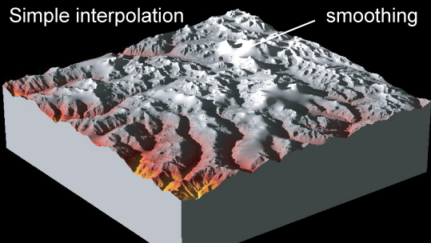

Slide 58
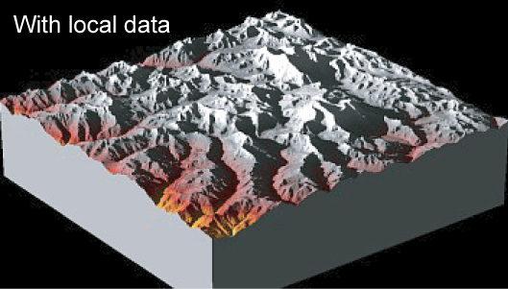
Interpolations improved by using local maps and other data sources
e.g hydrological surveys must be of comparable resolution to the raw DEM data)

Slide 59
REMOTE SENSING
Remote sensing technologies utilise the electromagnetic spectrum
Remote sensing sensors record the electromagnetic radiation reflected (or emitted) by a target
The absorption, reflection and transmission of electromagnetic radiation at different wavelengths vary for different materials

Slide 60
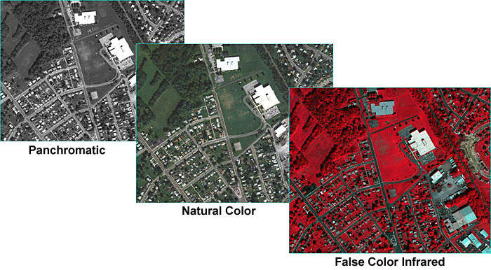
The reflected or emitted radiation is referred to as the spectral signature of a material
- used to differentiate between different targets
A single band of wavelengths (waveband) produces a greyscale or ‘Panchromatic’ image
Multiple wavebands recorded simultaneously produce a ‘Multi-spectral’ image

Slide 61
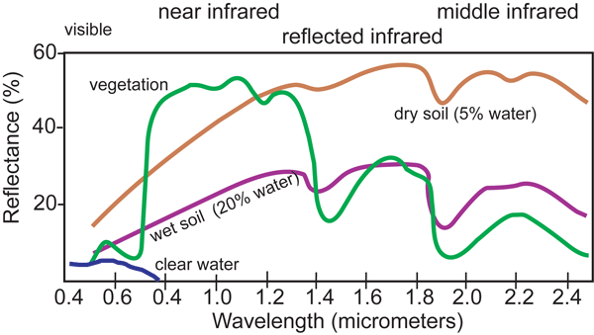
The ‘spectral response’ of common materials in the visible and near infrared spectrum
Remote sensing sensors record electromagnetic radiation in one or more wavelength ranges (spectral bands)

Slide 62
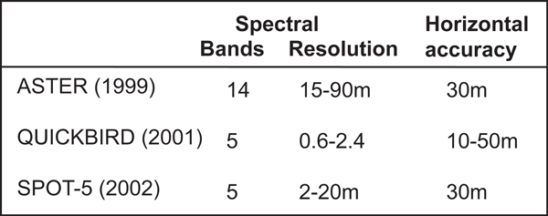
Spectral resolution = ability of a sensor to record data in discrete electromagnetic wavelength ranges
Radiometric resolution = ability of a sensor to discriminate very slight variations in the intensity of a measured waveband

Slide 63
SUMMARY
This lecture has outlined the core principles that underpin terrain mapping and remote sensing. Consideration of method resolution and accuracies provide a basic framework for selecting the best tool to address a particular geomorphic question.
Lecture 4 examines application of DEMS’ with commonly used geomorphic markers.
Before this, Lecture 3 considers a reference framework and topographic change, as we need to understand these aspects before making DEM interpretations.

Slide 64
Reading
Chapter 5 in Tectonic Geomorphology by Burbank and Anderson
Chapter 3 in Active Tectonics: Earthquakes, Uplift, and Landscape by Keller, E.A. and N. Pinter
Articles
Massonnet, D, 1997

Slide 65
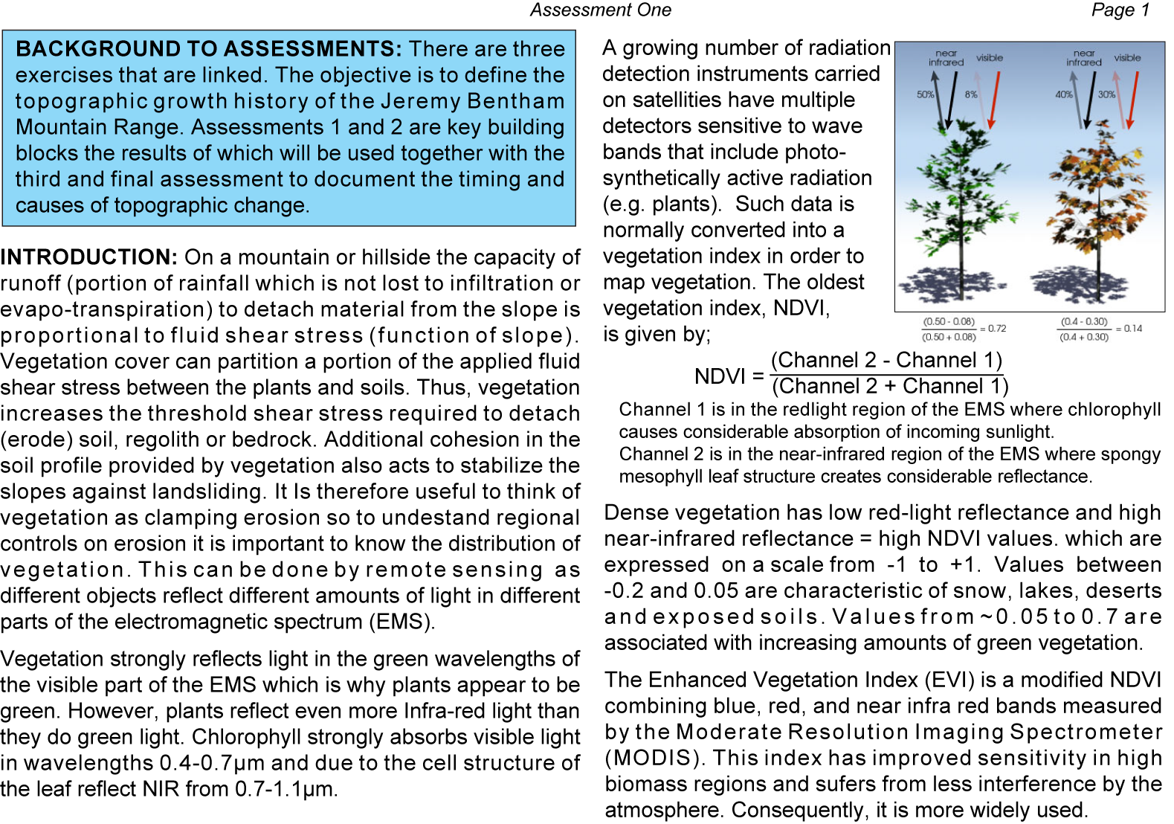
ASSESSMENT ONE
Deadline: 31st October

Slide 66
